Slide 1
Google Mock (GMock)

Slide 2
Google Mock (GMock)
Google Mock (GMock) is a C++ framework built on top of Google Test (GTest) that enables the creation of mock objects. It allows developers to simulate the behavior of real objects in controlled ways, making unit testing of dependent code more precise and effective.
Use Cases for Google Mock (gMock)
Mocking Interfaces: Replace real dependencies with mocks to isolate the unit under test.
Behavior Verification: Check if methods were called with expected arguments, order, and frequency.
Simulating Failures: Easily simulate edge cases like timeouts, exceptions, or invalid responses.
Rapid Prototyping: Test code before real implementations are ready by mocking dependencies.
Legacy Code Testing: Inject mocks into older codebases to improve testability without major refactoring

Slide 3
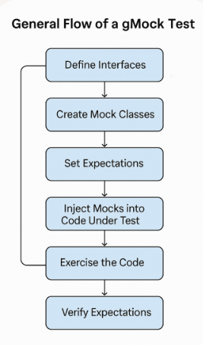
General Flow of a gMock Test
Define Interfaces Your production code should depend on abstract interfaces rather than concrete classes. This enables mocking.
Create Mock Classes Using gMock macros, you define mock versions of those interfaces. These mocks can simulate behavior and track interactions.
Set Expectations In your test, you specify how the mock should behave — what methods should be called, with what arguments, how many times, and what they should return.
Inject Mocks into Code Under Test The mock is passed into the component you're testing, typically via dependency injection.
Exercise the Code Run the function or method you want to test. It will interact with the mock instead of a real dependency.
Verify Expectations gMock automatically checks whether the interactions matched your expectations. If not, the test fails.

Slide 4

MOCK_METHOD
MOCK_METHOD is a macro provided by Google Mock that lets you simulate (mock) a method from a base class. It creates a fake version of the method that:
- Can track how it’s called
- Can return custom values
- Can be used to verify interactions in your tests
- ReturnType: What the method returns (e.g. void, int, bool)
- MethodName: The name of the method you're mocking
- Args...: The method’s parameters (e.g. (int distance))
- Specifiers: Things like override, const, noexcept,

Slide 5
EXPECT_CALL
EXPECT_CALL is a macro used to set expectations on how a mock object should be used during a test. It tells Google Mock “I expect this method to be called, possibly with specific arguments, and possibly a certain number of times.”
Controlling Call Frequency
You can chain .Times() to control how often the method should be called:
- .Times(1) — exactly once
- .Times(AtLeast(1)) — one or more times
- .Times(Exactly(3)) — exactly three times
- .Times(AnyNumber()) — any number of times (including zero)
Use EXPECT_CALL?
- To verify behavior: Did your code call the right methods?
- To simulate dependencies: You don’t need real implementations.
- To catch bugs early: If something’s missing or out of order, the test fails.

